Slide 1
Classes for Processing Strings
BACS2023
Object-Oriented Programming
Chapter 5

Slide 2
Learning Outcomes
At the end of this lesson, you should be able to:
Describe the implementation of strings as objects in Java.
Use the String class to process fixed strings.
Use the Character class to process a single character.
Use the StringBuilder / StringBuffer classes to process flexible strings.
Distinguish among the String, StringBuilder and StringBuffer classes.

Slide 3
1. The String Class
A string is a sequence of characters.
In many languages, strings are implemented as arrays of characters, but in Java a string is an object.
The String class has 11 constructors and more than 40 methods for manipulating strings.

Slide 4
The String Class
Provides constructors and methods for
Constructing string objects
Obtaining string length
Retrieving individual characters in a string (charAt)
String concatenation (concat)
Substrings (substring)
Comparisons (equals, compareTo)
String conversions
Finding a character or a substring in a string
Conversions between strings and arrays
Converting characters and numeric values to strings

Slide 5
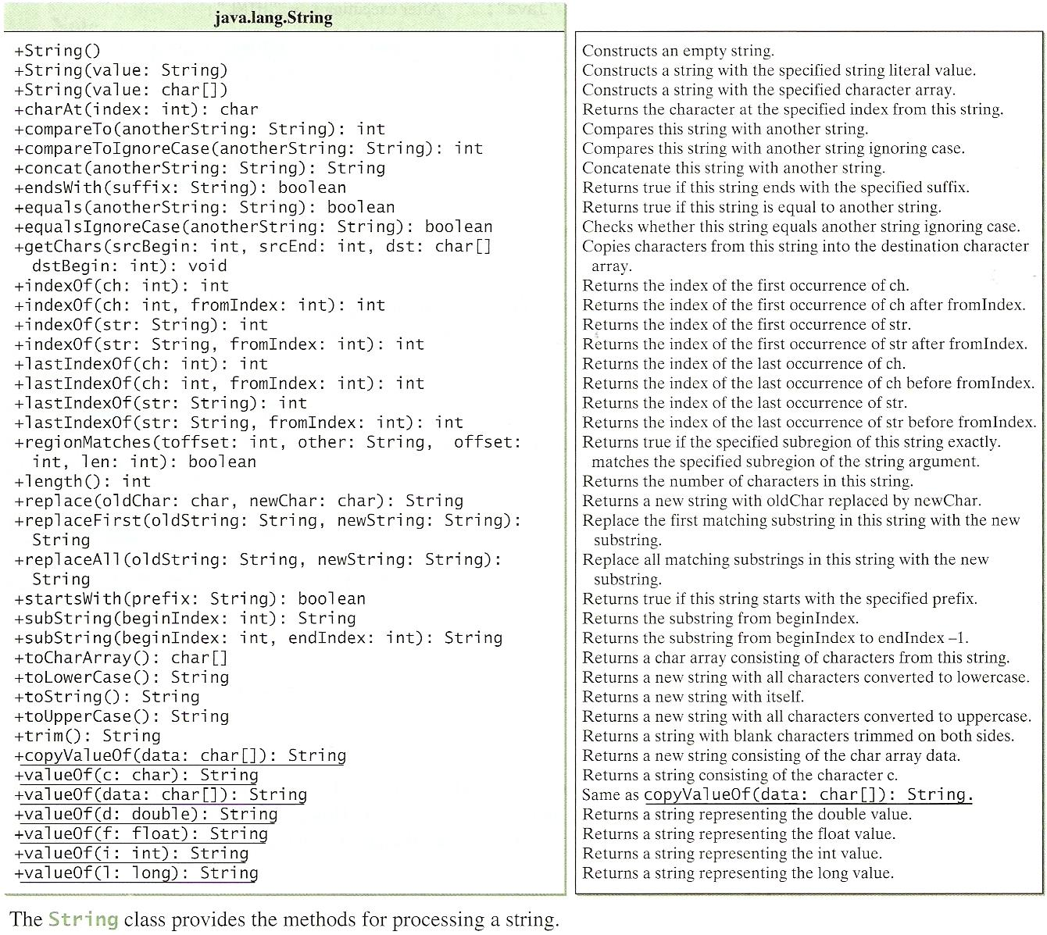

Slide 6
1.1 Constructing Strings
From a string literal
  (i) Syntax: String newString = new String(stringLiteral);
E.g.: String message = new String("Welcome to Java");
  (ii) Java treats a string literal as a String object. Hence, the keyword new
  may be omitted:
Eg: String message = "Welcome to Java";
From an array of characters
char[] charArray = {‘G’,‘o’,‘o’,‘d’,‘ ’,‘D’,‘a’,‘y’};
String message = new String(charArray);

Slide 7

String Variable, Object and Value
Strictly speaking, all the following terms are different:
  String Variable
  String Object
  String Value
A string variable holds a reference to a string object that stores a string value.
However, most of the time, the distinctions between them can be ignored.

Slide 8

1.2 Strings Are Immutable
A String object is immutable
  its contents cannot be changed.
Does the following code change the contents of the string?
  String s = "Java";
  s = "HTML";

Slide 9
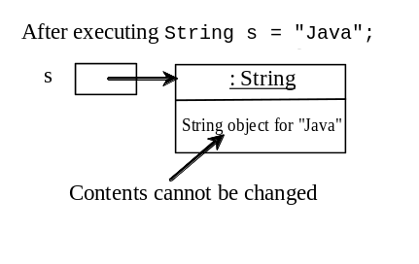
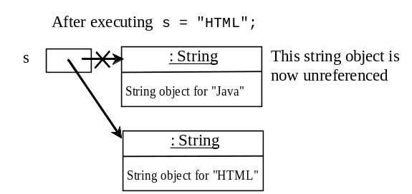
Strings are Immutable
String s = "Java";
s = "HTML";
String s = "Java";

Slide 10
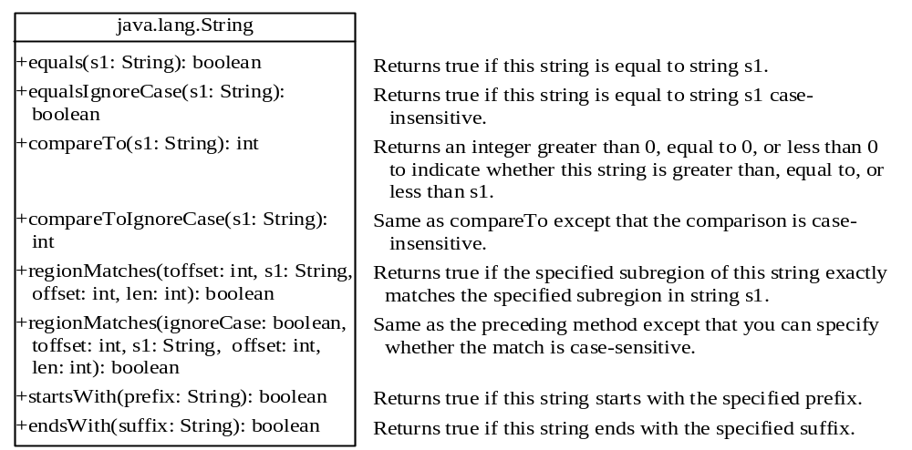
1.3 String Comparisons

Slide 11
String Comparisons
equals() method
String s1 = new String("Welcome“);
String s2 = "welcome";
if (s1.equals(s2)){
// s1 and s2 have the same contents
}
if (s1 == s2) {
// s1 and s2 have the same reference
}

Slide 12
String Comparisons
compareTo(Object object) method
String s1 = new String("Welcome“);
String s2 = "welcome";
if (s1.compareTo(s2) > 0) {
// s1 is greater than s2
}
else if (s1.compareTo(s2) == 0) {
// s1 and s2 have the same contents
}
else
// s1 is less than s2

Slide 13
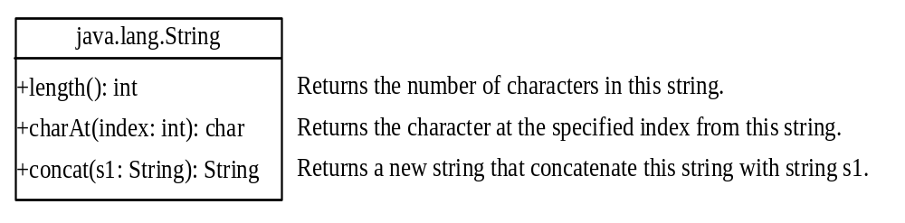
1.4 String Length, Characters, and Combining Strings

Slide 14
Finding String Length
length() method
  message = "Welcome";
  System.out.println(message.length());
  // message.length() will return 7

Slide 15

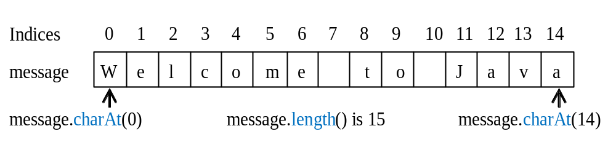
Retrieving Individual Characters in a String
Use message.charAt(index)
Index starts from 0
Do not use message[0]

Slide 16

String Concatenation
To concatenate s1 and s2 into s3 :
String s3 = s1.concat(s2);
or using Java’s shorthand concatenation operator:
String s3 = s1 + s2;
s1 + s2 + s3 + s4 + s5 is the same as
(((s1.concat(s2)).concat(s3)).concat(s4)).concat(s5);

Slide 17

Objective: Checking whether a string is a palindrome: a string that reads the same forward and backward.
E.g: pop, madam, etc
CheckPalindrome

Slide 18
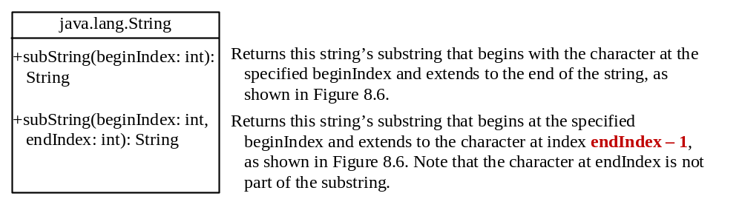
1.5 Extracting Substrings

Slide 19
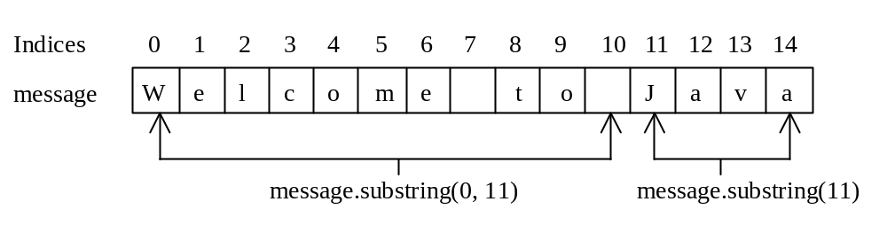
Extracting Substrings
Use the substring method in the String class to extract a substring from a string.
String s1 = "Welcome to Java";
String s2 = s1.substring(0, 11) + "HTML";

Slide 20
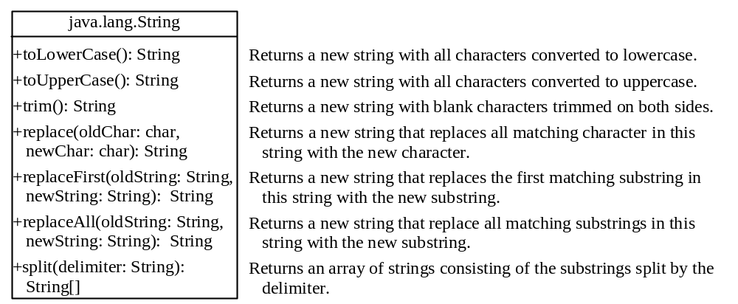
1.6 Converting, Replacing, and Splitting Strings

Slide 21
String Conversions
The contents of a string cannot be changed once the string is created, but you can convert a string to a new string using the following methods:
  toLowerCase()
  toUpperCase()
  trim()
  replace(oldChar, newChar)

Slide 22
String Conversion Examples
Method call
"Welcome".toLowerCase()
"Welcome".toUpperCase()
" Welcome ".trim()
"Welcome".replace('e', 'A')
"Welcome".replaceFirst("e", "AB")
"Welcome".replace("e", "AB")
"Welcome".replace("el", "AB")
New string returned
WELCOME
welcome
welcome
WAlcomA
WABlcome
WABlcomAB
WABcome

Slide 23
Splitting a String
String[] tokens = "Java#HTML#Perl".split("#”);
for (int i = 0; i < tokens.length; i++)
System.out.print(tokens[i] + " ");
tokens
displays
Java HTML Perl
Java
HTML
Perl

Slide 24
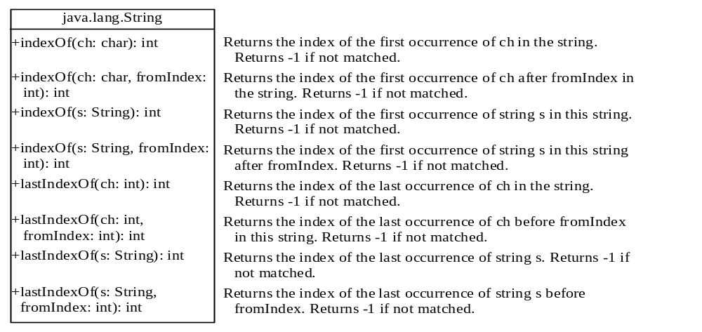
1.7 Finding a Character or a Substring in a String

Slide 25
Finding a Character or a Substring in a String
Method call
"Welcome to Java".indexOf('W')
"Welcome to Java".indexOf('x')
"Welcome to Java".indexOf('o', 5)
"Welcome to Java".indexOf("come")
"Welcome to Java".indexOf("Java", 5)
"Welcome to Java".indexOf("java", 5)
"Welcome to Java".lastIndexOf('a')
Value returned
0
-1
9
3
11
-1
14

Slide 26
1.8 Convert Character and Numbers to Strings
The String class provides several static valueOf methods for converting a character, an array of characters, and numeric values to strings.
These methods have the same name valueOf with different argument types char, char[], double, long, int, and float.
Example
System.out.printf("String.valueOf(5.44) is %s \n", String.valueOf(5.44));
char [] c={'h','a','p','p', 'y'};
System.out.printf("String.valueOf(c) is %s \n", String.valueOf(c));

Slide 27
2. The Character Class
Java provides a wrapper class for every primitive data type.
Wrapper classes enable primitive data values to be treated as objects.

Slide 28
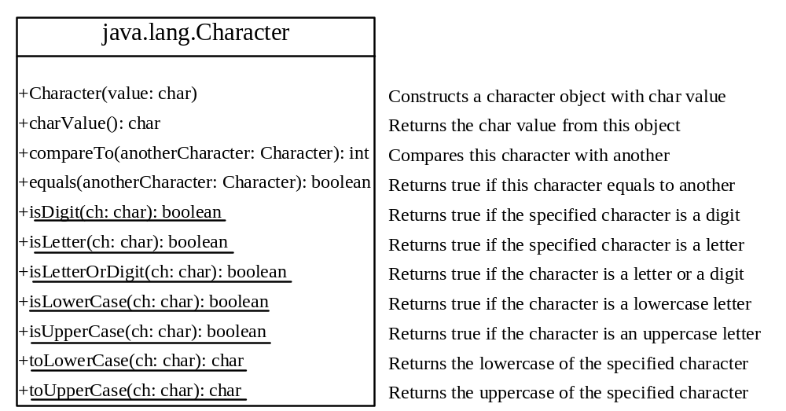
The Character Class

Slide 29
Examples using Character Objects
Character charObject = new Character('b');
charObject.compareTo(new Character('a')) returns 1
charObject.compareTo(new Character('b')) returns 0
charObject.compareTo(new Character('c')) returns -1
charObject.compareTo(new Character('d') returns –2
charObject.equals(new Character('b')) returns true
charObject.equals(new Character('d')) returns false

Slide 30
3. StringBuilder and StringBuffer
The StringBuilder/StringBuffer class is an alternative to the String class.
In general, a StringBuilder/StringBuffer can be used wherever a string is used.
StringBuilder/StringBuffer is more flexible than String.
  You can add, insert, or append new contents into a string buffer, whereas the value of a String object is fixed once the string is created.

Slide 31
StringBuilder and StringBuffer
Use StringBuffer if it may be accessed by multiple tasks concurrently.
Use StringBuilder if it is accessed by a single task – it is more efficient.
The constructors and methods in StringBuilder and StringBuffer are almost the same.
This lecture covers StringBuilder . You may replace StringBuilder by StringBuffer. The program can compile and run without any other changes.

Slide 32
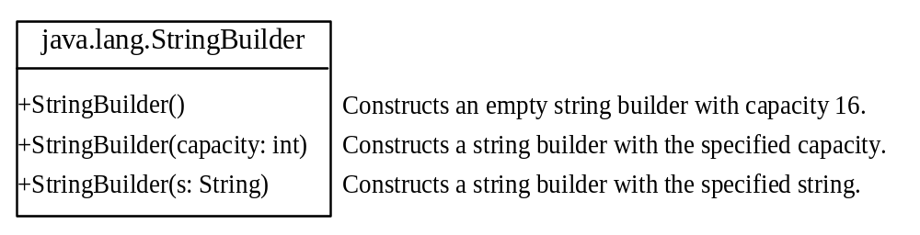
StringBuilder Constructors

Slide 33

Modifying Strings in StringBuilder

Slide 34
Examples of using StringBuilder methods
StringBuilder stringBuilder = new StringBuilder("Welcome to ");
stringBuilder.append("Java"); // builder contains “Welcome to Java”
(a) stringBuilder.insert(11, "HTML and ");
// builder contains “Welcome to HTML and Java”
(b) stringBuilder.delete(8, 11) // changes the builder to “Welcome Java”
(c) stringBuilder.deleteCharAt(8) // changes the builder to “Welcome o Java”
(d) stringBuilder.reverse() // changes the builder to “avaJ ot emocleW”
(e) stringBuilder.replace(11, 15, "HTML")
// changes the builder to “Welcome to HTML”
(g) stringBuilder.setCharAt(0, 'w') // sets the builder to “welcome to Java.”

Slide 35

The toString, capacity, length, setLength, and charAt Methods

Slide 36
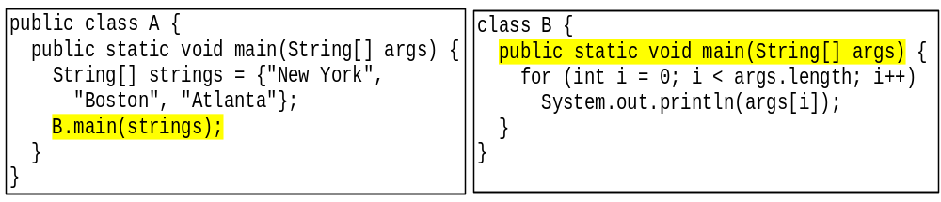
4. main Method is just a Regular Method
You can call a regular method by passing actual parameters.
Can you pass arguments to main?
  Of course, yes. For example, the main method in class B is invoked by a method in A, as shown below:

Slide 37
Command-Line Parameters
class TestMain {
public static void main(String[] args) {
for(int i = 0; i < args.length; i++){
System.out.println(args[i]);
}
}
}
The main method gets the arguments from args[0], args[1], args[2], ..., args[n], which corresponds to arg0, arg1, arg2, ..., argn in the command line.
java TestMain arg0 arg1 arg2 ... argn
Example:
java TestMain “First Num” alpha 53

Slide 38
5. Regular Expressions [self study]
A regular expression (abbreviated regex) is a string that describes a pattern for matching a set of strings.
Regular expression is a powerful tool for string manipulations. You can use regular expressions for matching, replacing, and splitting strings.
A regular expression consists of literal characters and special symbols.

Slide 39
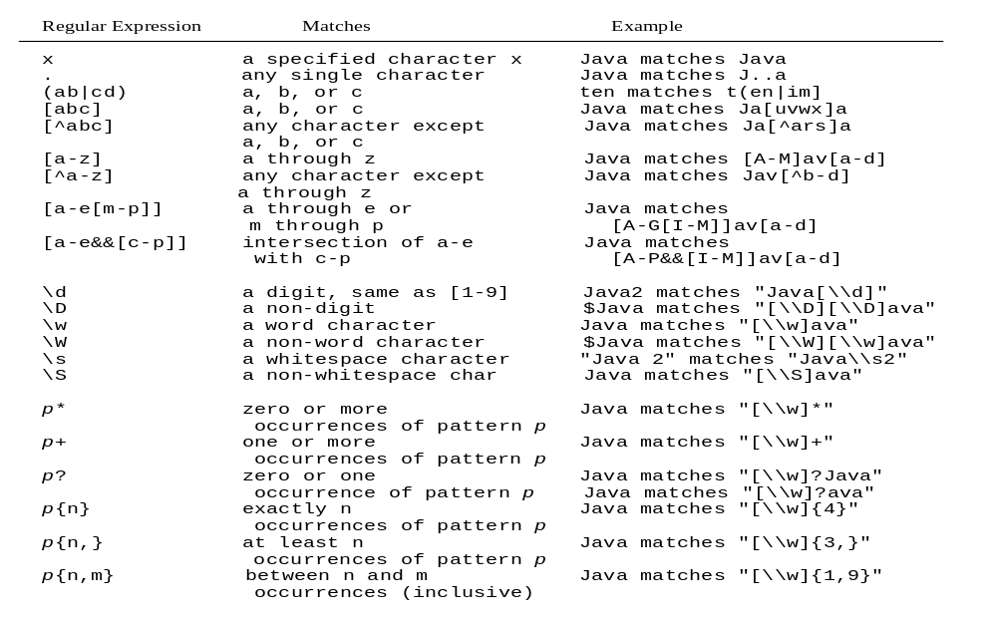
Regular Expression Syntax [self study]

Slide 40
Regular Expressions Examples [self study]
A regular expression for handphone numbers is:
  [\\d]{3}-[\\d]{7} // 012-3332211
A regular expression for even numbers is:
  [\\d]*[02468]
A regular expression to match the strings “Welcome to Java” or “Welcome to HTML” is:
  “Welcome to (Java|HTML)”
A regular expression to match any strings is:
  “.*”
Notes:
String tel = "012-899995";
boolean f = tel.matches("[\\d]{3}-[\\d]{7}");
System.out.println("telephone no valid : " +tel.matches("[\\d]{3}-[\\d]{7}"));

Slide 41
Matching Strings [self study]
"Java".matches("Java");
"Java".equals("Java");
"Java is fun".matches("Java.*")
"Java is cool".matches("Java.*")
"Java is powerful".matches"Java.*")
The substring .* matches any zero or more characters.
"Java.*“ is a regular expression. It represents a string pattern that begins Java with followed by any zero or more characters.

Slide 42
Replacing and Splitting by Patterns [self study]
The replaceAll, replaceFirst and split methods can be used with a regular expression. For example, the following statement returns a new string that replaces $, +, or # in "a+b$#c" by the string NNN.
  String s = "a+b$#c".replaceAll("[$+#]", "NNN");
  System.out.println(s);
  Here the regular expression [$+#] specifies a pattern that matches $, +, or #. So, the output is aNNNbNNNNNNc.

Slide 43
Replacing and Splitting by Patterns [self study]
The following statement splits the string into an array of strings delimited by some punctuation marks.
  String[] tokens = "Java,C?C#,C++".split("[.,:;?]");
  for (int i = 0; i < tokens.length; i++)
  System.out.println(tokens[i]);
Output
  Java
  C
  C#
  C++

Slide 44
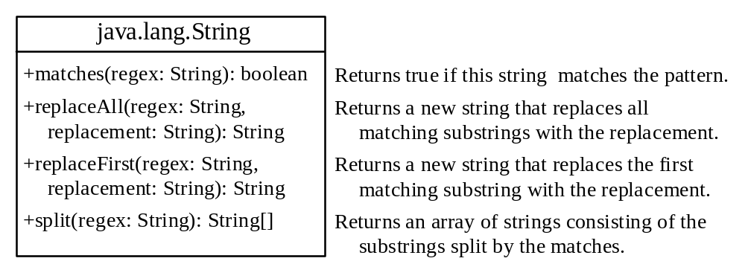
Replacing and Splitting Strings [self study]

Slide 45
Replacing and Splitting Strings [self study]
String s = "Java Java Java".replaceAll("v\\w", "wi") ;
String s = "Java Java Java".replaceFirst("v\\w", "wi") ;
String[] s = "Java1HTML2Perl".split("\\d");
Note
Backslash is a special character that starts an escape sequence in a string. Therefore, you need to use it before any regular expressions that contains a backslash.
\w is a regular expression that represents a word character (i.e., [a-zA-Z0-9])
\d or [1-9] is a regular expression that represents a digit.

Slide 46
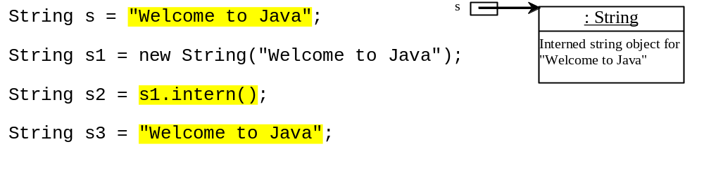
6. Interned Strings (1) [self study]
Since strings are immutable and are frequently used, to improve efficiency and save memory, the JVM uses a unique instance for string literals with the same character sequence.
Such an instance is called interned. You can also use a String object’s intern method to return an interned string.

Slide 47
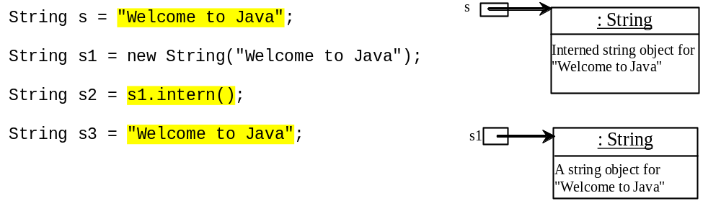
Interned Strings (2) [self study]

Slide 48
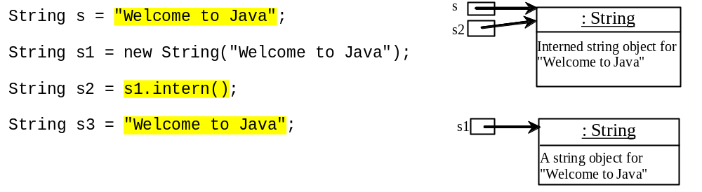
Interned Strings (3) [self study]
Notes:
Intern will refer to memory pool

Slide 49
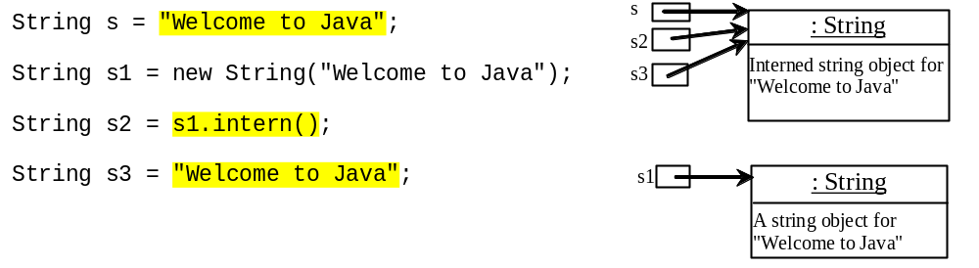
Interned Strings (4) [self study]

Slide 50
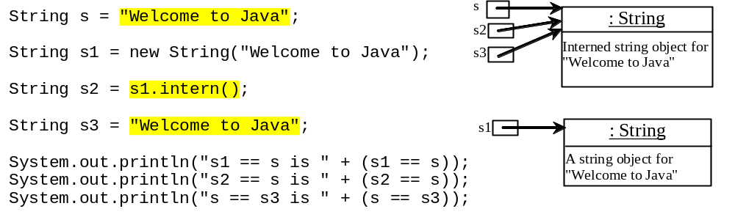
Interned Strings (5) [self study]
A new object is created if you use the new operator.
If you use the string initializer, no new object is created if the interned object is already created.
Output
s1 == s is false
s2 == s is true
s == s3 is true

Slide 51
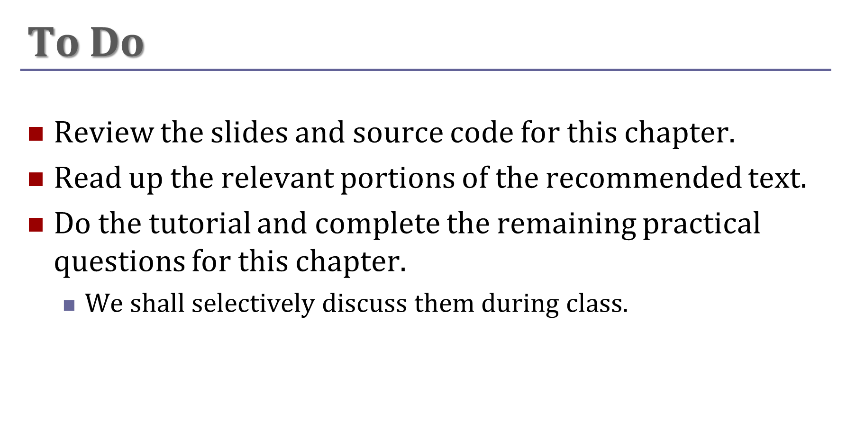
Extracted from slides by Liang, Introduction to Java Programming, 9th Edition © 2013, Prentice Hall

